Slide 1
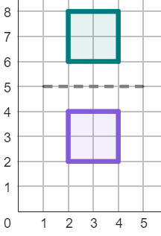
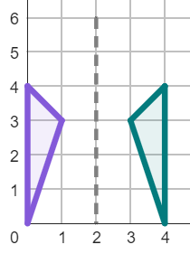

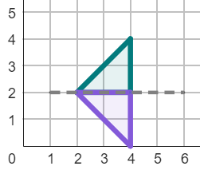
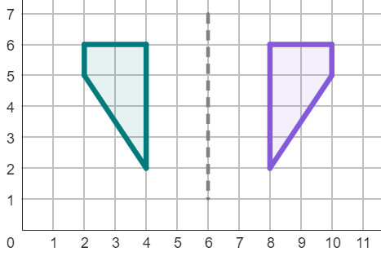
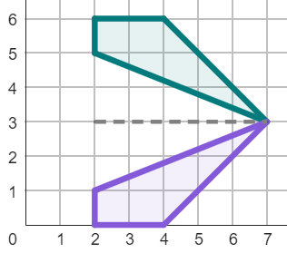
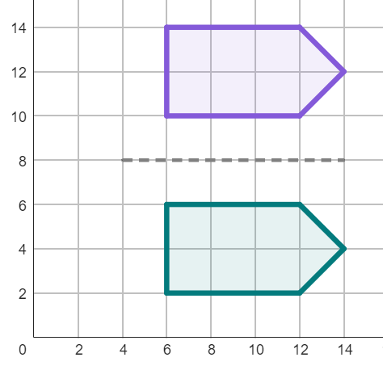
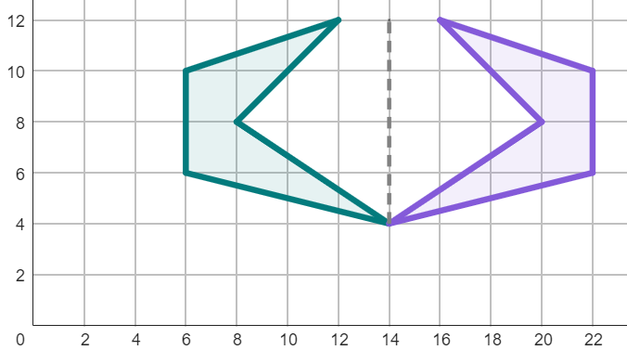
Describing a reflection
Task A: Describing a reflection with formal language
1) Match the descriptions to the reflections.
Description 1
b
Horizontal reflection
Line of reflection through the coordinates (2, 5) and (2, 0).
a
b
Description 2
c
Vertical reflection
Line of reflection through the coordinates (5, 2) and (0, 2).
Description 3
a
Vertical reflection
Line of reflection through the coordinates (2, 5) and (0, 5).
c
2) Complete the descriptions of these reflections.
Description 1
Description 2
horizontal
horizontal
reflection
Line of reflection through the
coordinates ( , 5) and ( , 1).
.
Line of reflection through the
coordinates ( , ) and ( , ).
6
6
m
3
n
3
m and n can be any number.
3) Write full descriptions to these reflections.
Description 1
Description 2
Vertical reflection
Line of reflection through the coordinates (m, 8) and (n, 8).
Horizontal reflection
Line of reflection through the coordinates (14, a) and (14, b).
m and n can be any number.
a and b can be any number.
1

Slide 2
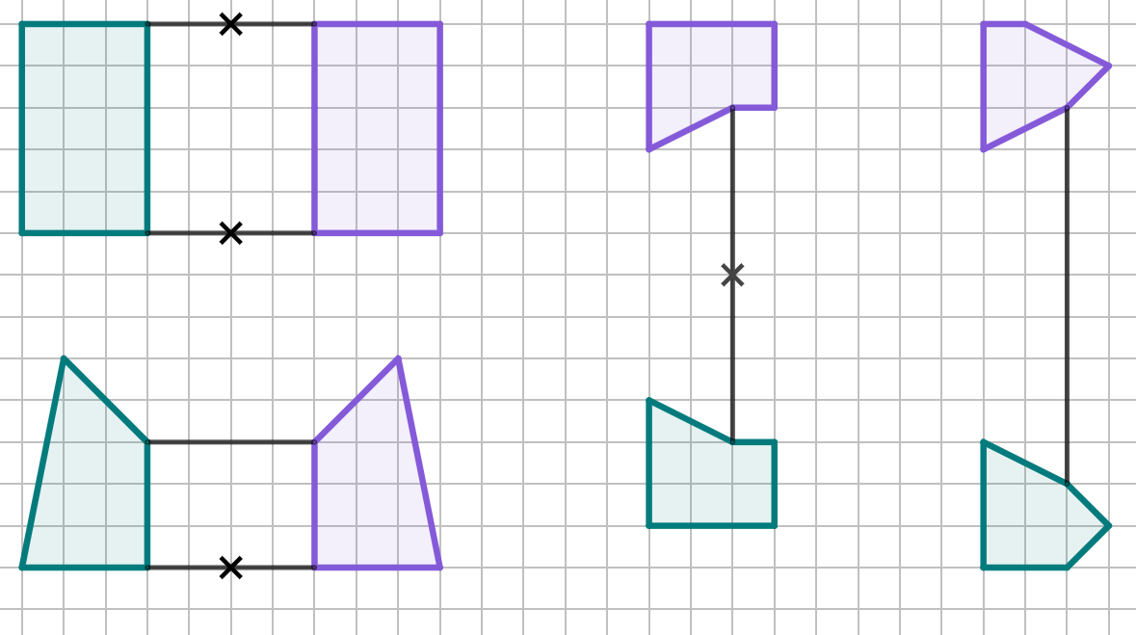
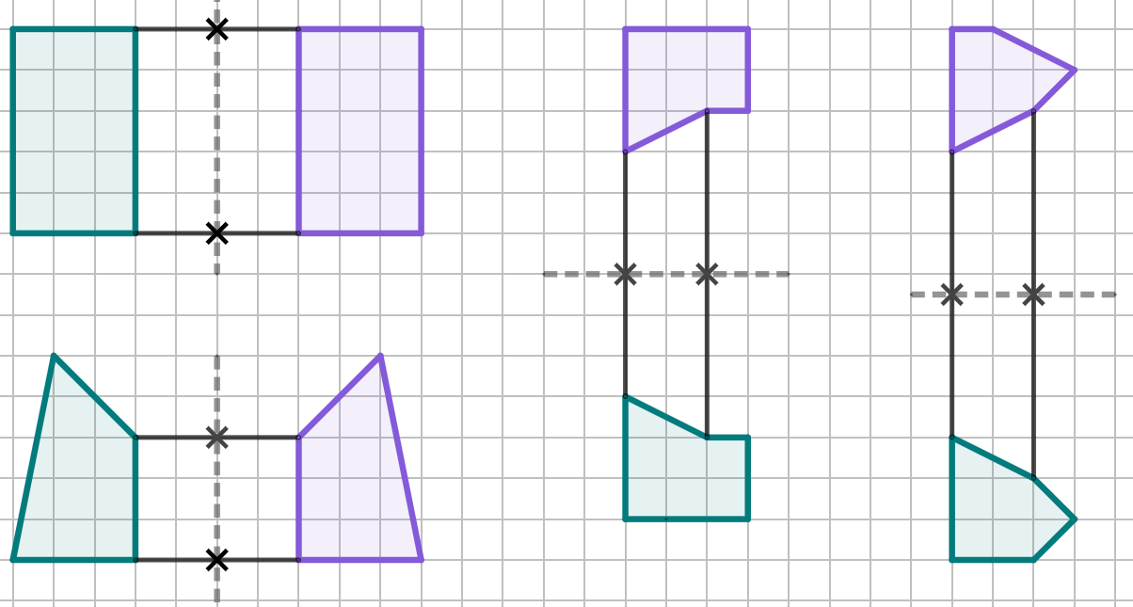
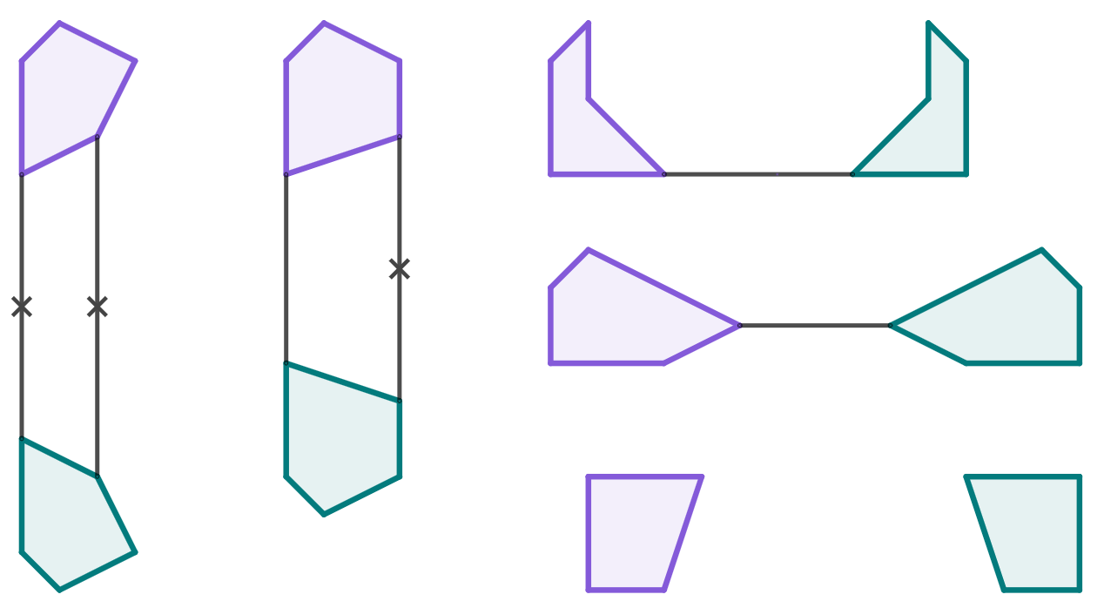
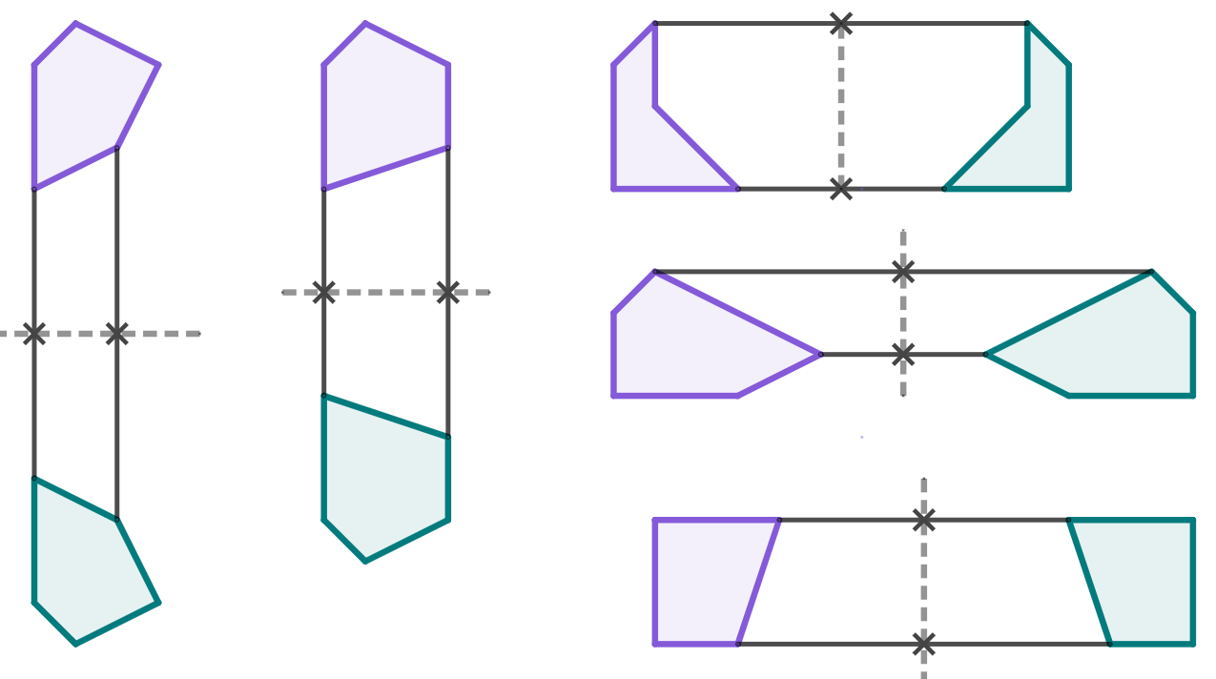
Describing a reflection
Task B: Applying strategies for finding the mirror line
1) Find the line of reflection for each of these partially completed diagrams.
2) Find the line of reflection for each of these partially completed diagrams. You will need to use a ruler.
There will be other correct answers, depending on which pairs of corresponding points you chose.

Slide 3
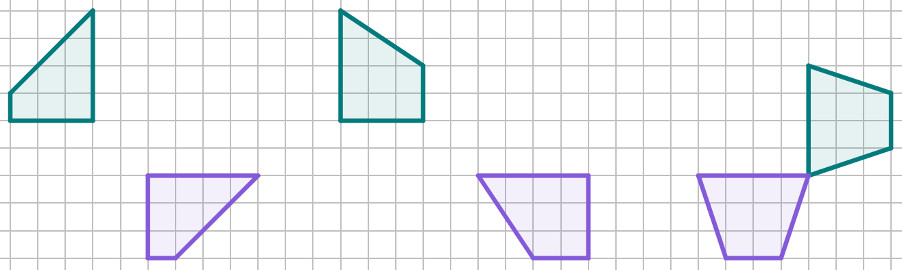


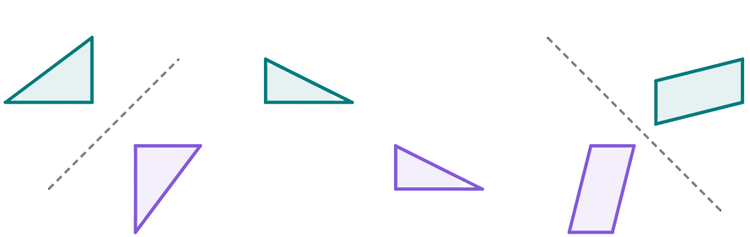
Describing a reflection
Task C: Diagonal reflections and non-reflections
1a) Which of these is a non-reflection? Draw line segments between corresponding points to find out!
b) Draw the line of reflection for all diagrams that show a reflection.
2a) Which of these is a non-reflection? Use a ruler to help you find out!
b) Draw the line of reflection for all diagrams that show a reflection.
Mathematics in Education and Industry
v2.2

